Slide 1
DANCING ROBOT

Slide 2
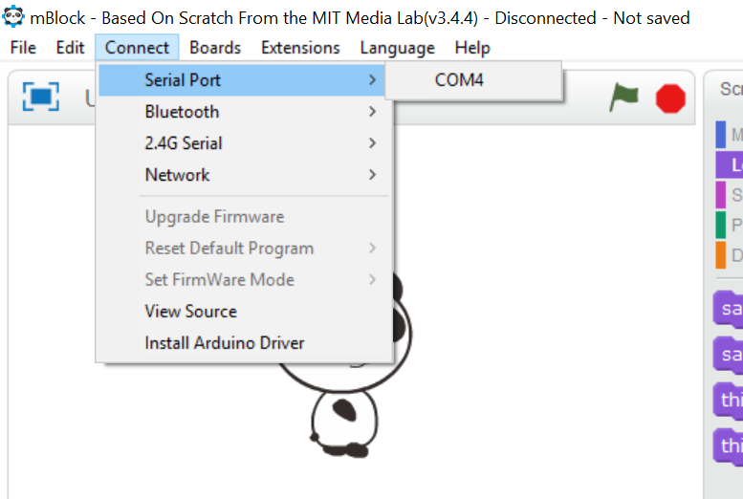
STEP 1. launch your Mblock
Start your mBlock application in your computer
Connect your mBlock to your computer using the USB cable.
Select Connect > Serial Port > COM4

Slide 3
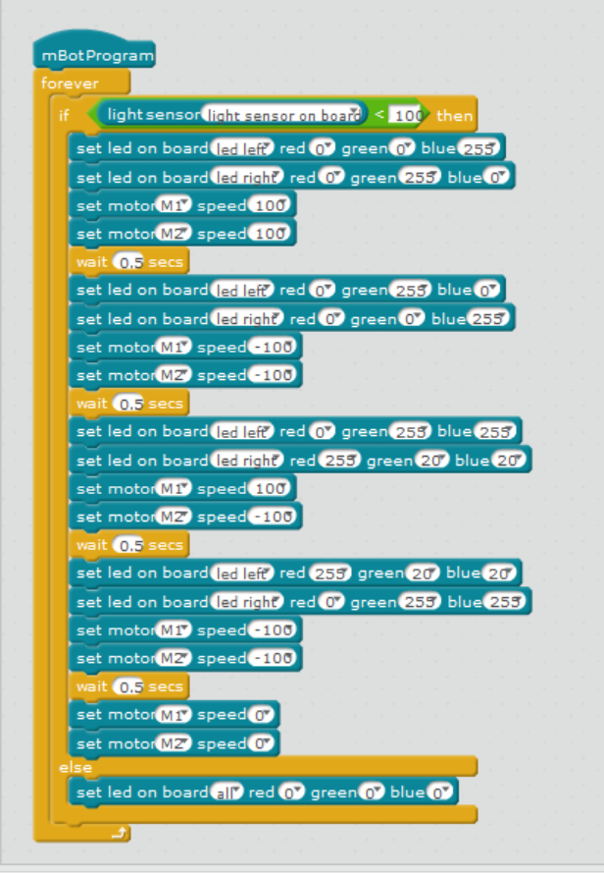
STEP 2. WRITE the Program
This program uses the light sensors that attached to your mBot.
Using the tools from the Events, Controls and Robot section, write the following code
Your program should look like this !

Slide 4
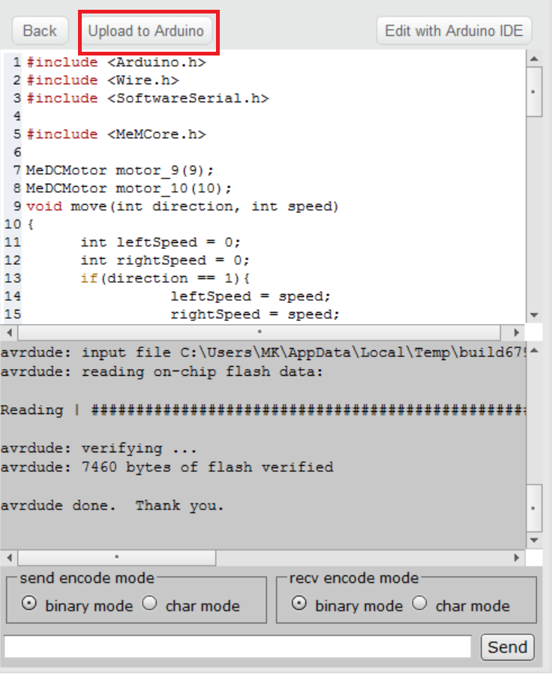
STEP 3: Upload the program
Press anywhere on the program, a new screen will open from the right side of the application
Now, press Upload to Arduino
When the uploading is done, press finish
Disconnect the USB cable and switch off the lights to see your mBot dancing !!

